Slide 1
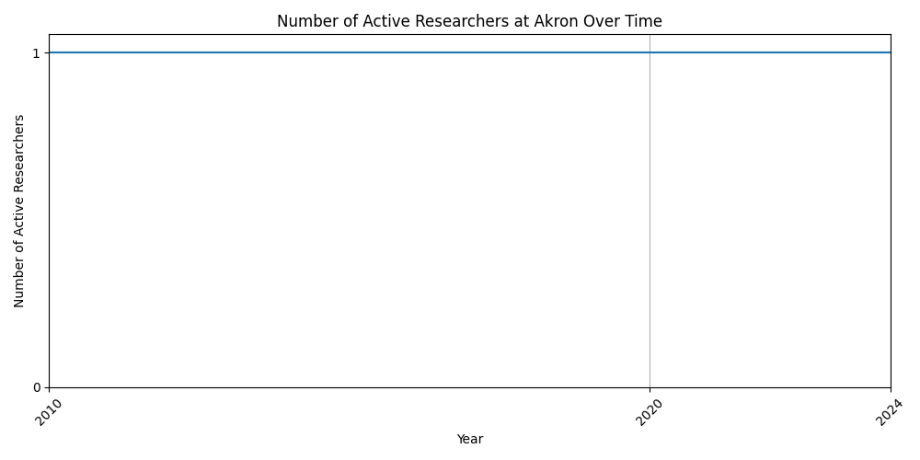
Researchers at Akron

Slide 2
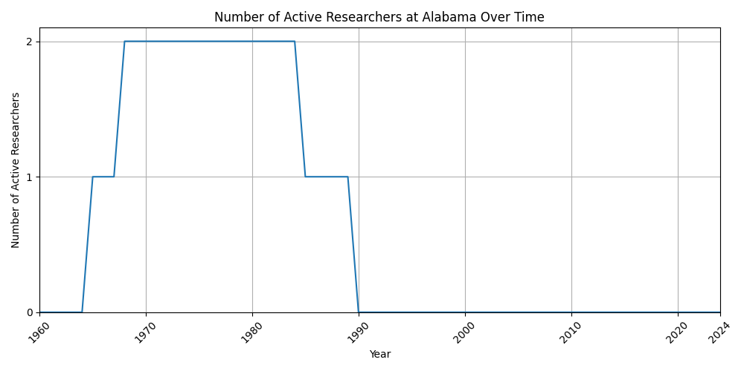
Researchers at Alabama

Slide 3
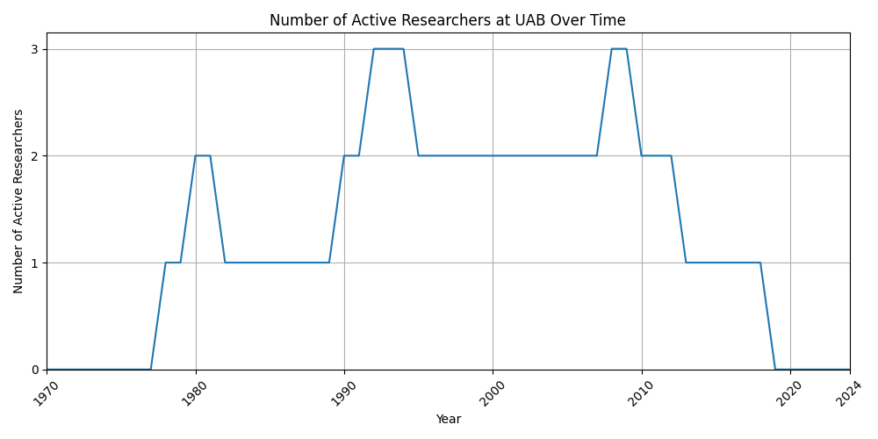
Researchers at UAB

Slide 4
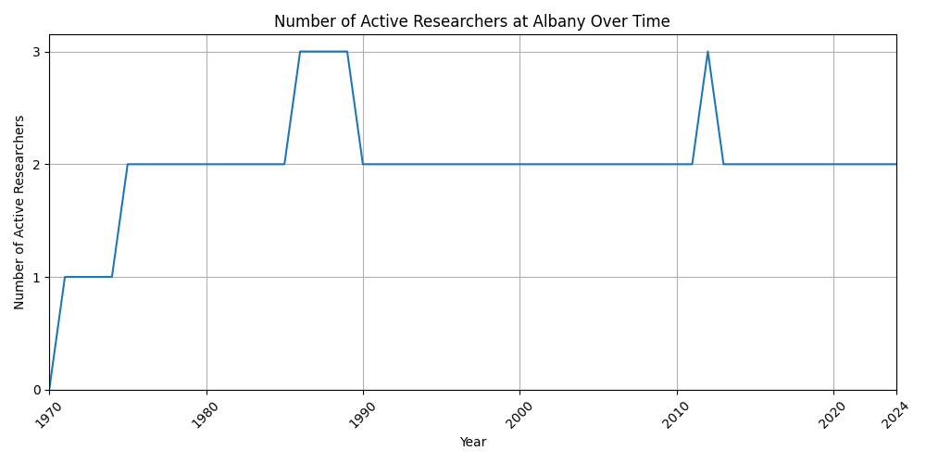
Researchers at Albany

Slide 5
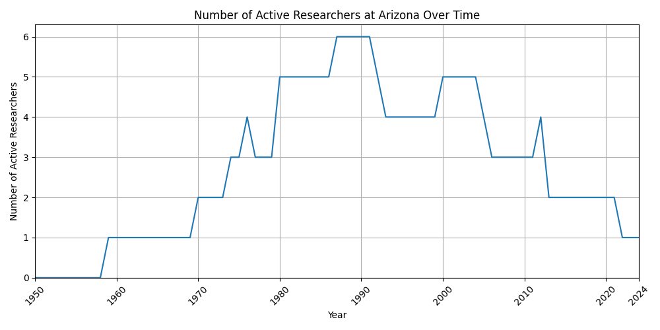
Researchers at Arizona

Slide 6
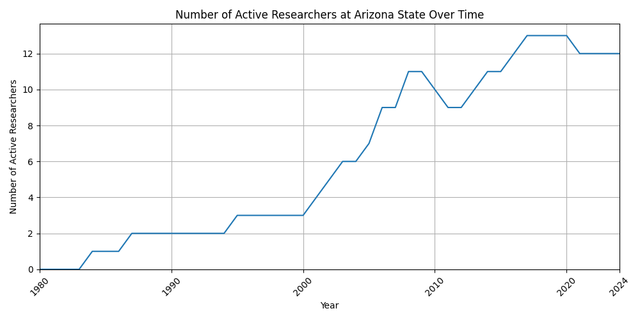
Researchers at Arizona State

Slide 7
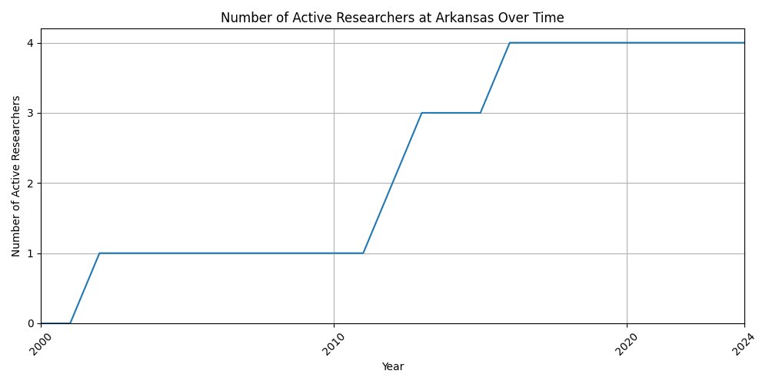
Researchers at Arkansas

Slide 8
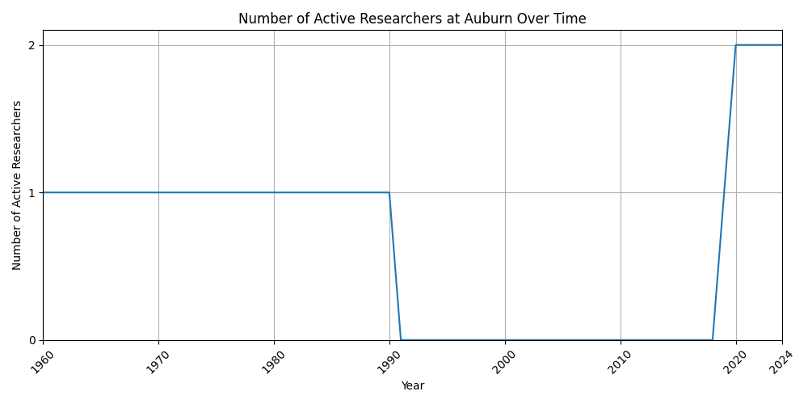
Researchers at Auburn

Slide 9
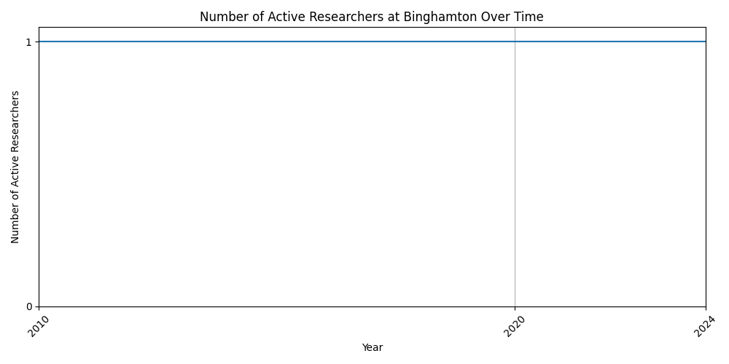
Researchers at Binghamton

Slide 10
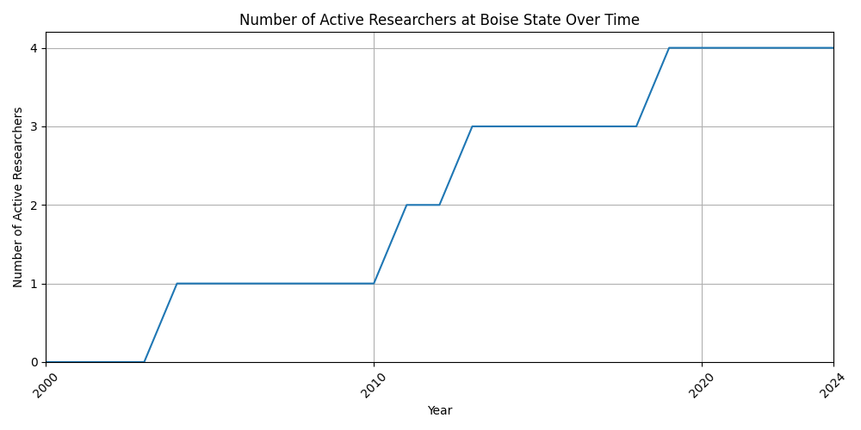
Researchers at Boise State

Slide 11
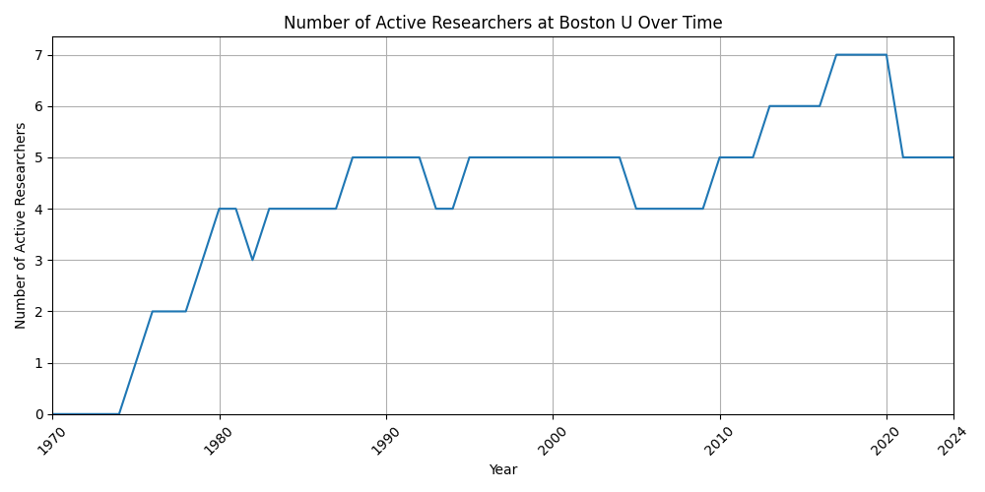
Researchers at Boston U

Slide 12
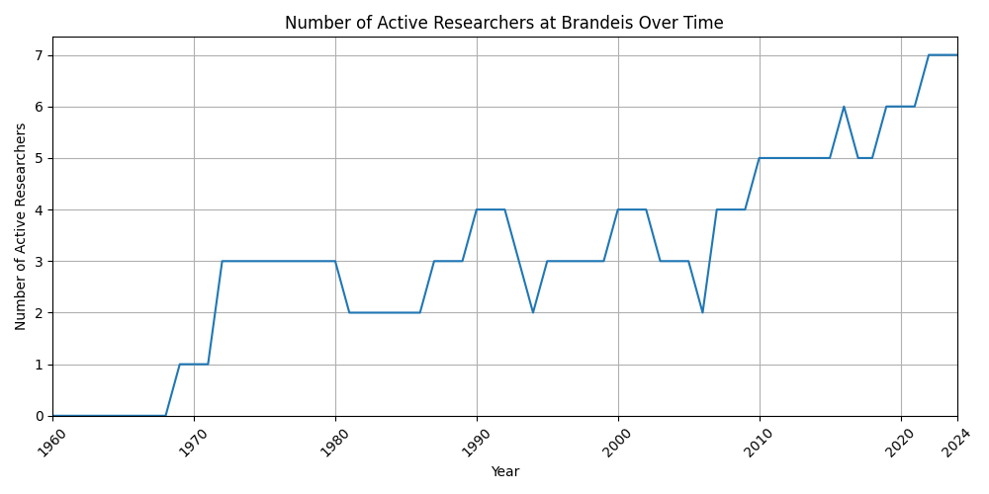
Researchers at Brandeis

Slide 13
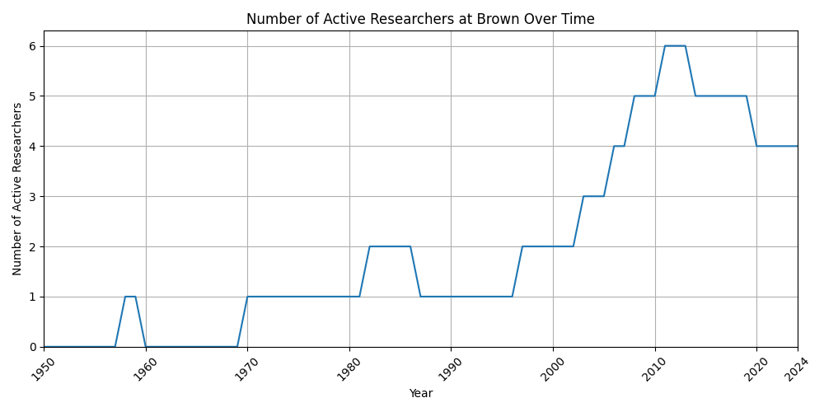
Researchers at Brown

Slide 14
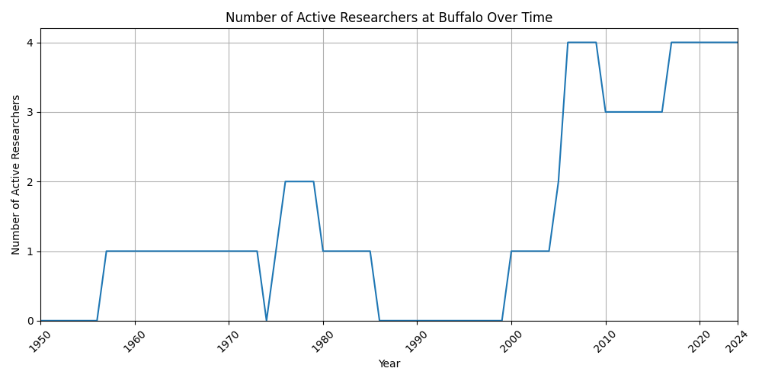
Researchers at Buffalo

Slide 15
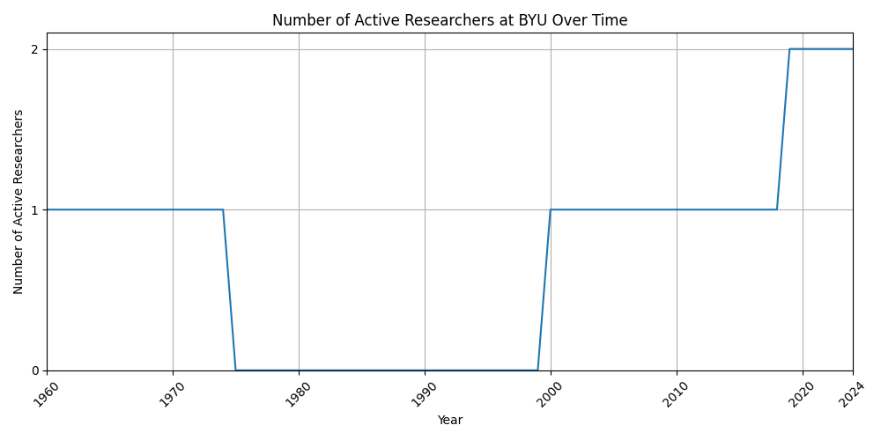
Researchers at BYU

Slide 16
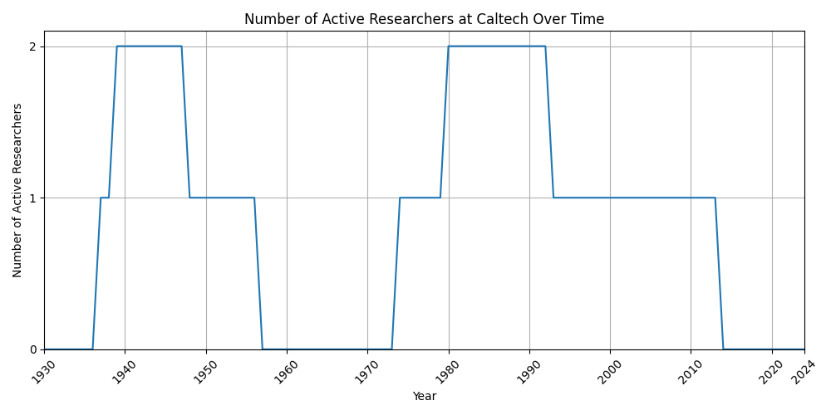
Researchers at Caltech

Slide 17
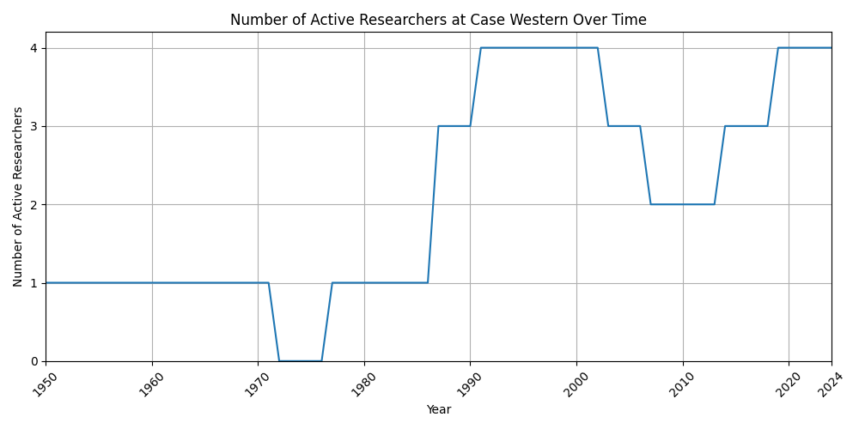
Researchers at Case Western

Slide 18
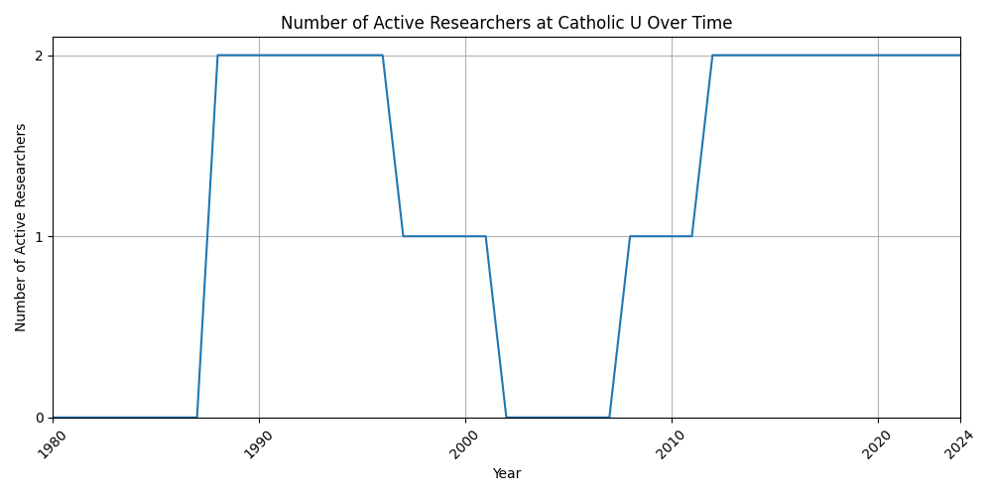
Researchers at Catholic U

Slide 19
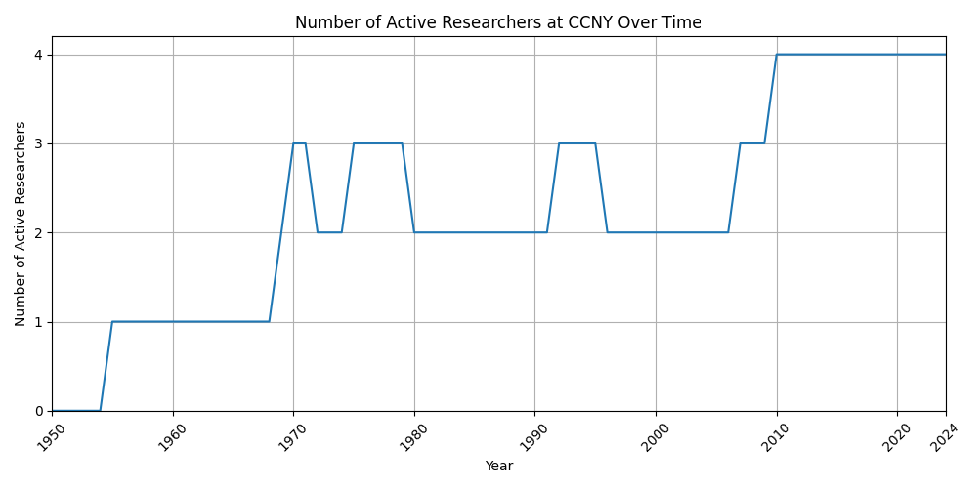
Researchers at CCNY

Slide 20
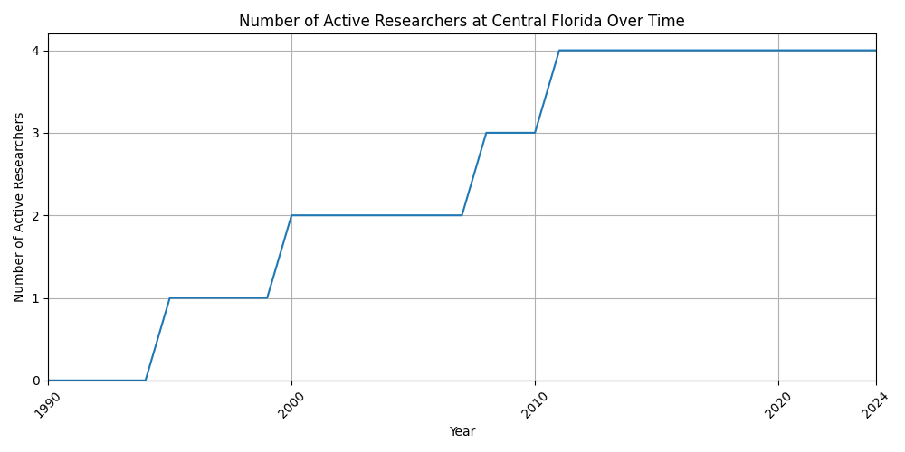
Researchers at Central Florida

Slide 21
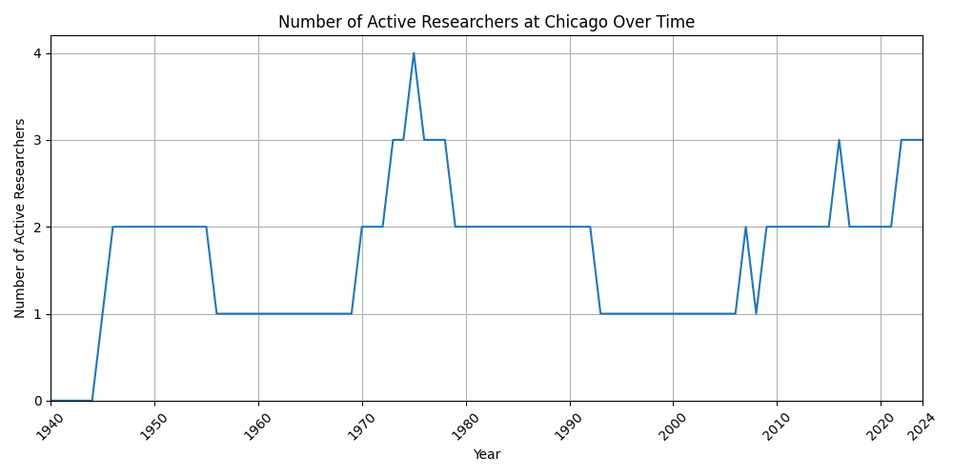
Researchers at Chicago

Slide 22
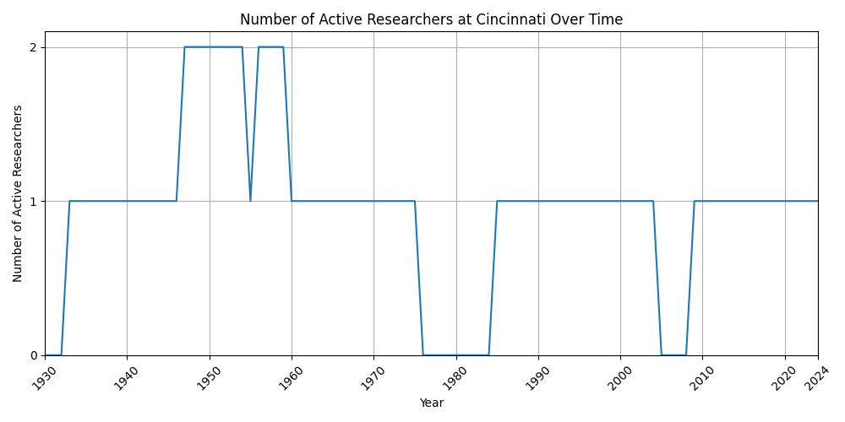
Researchers at Cincinnati

Slide 23
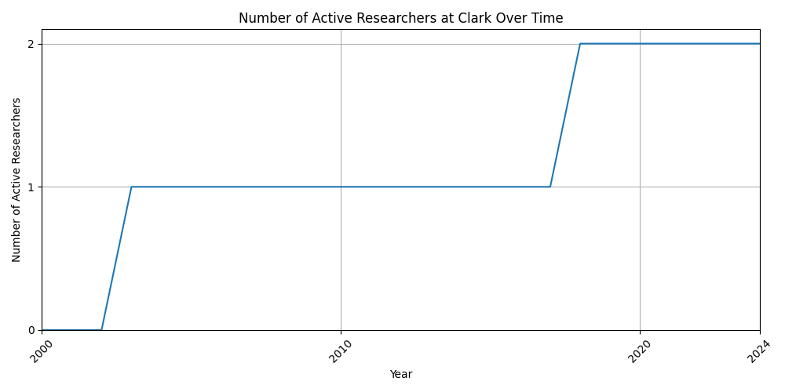
Researchers at Clark

Slide 24
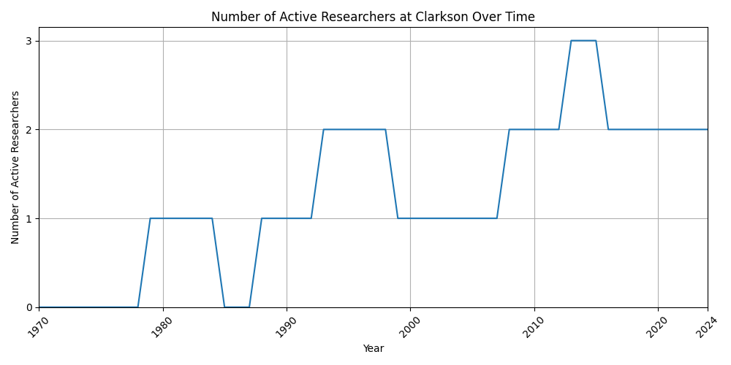
Researchers at Clarkson

Slide 25
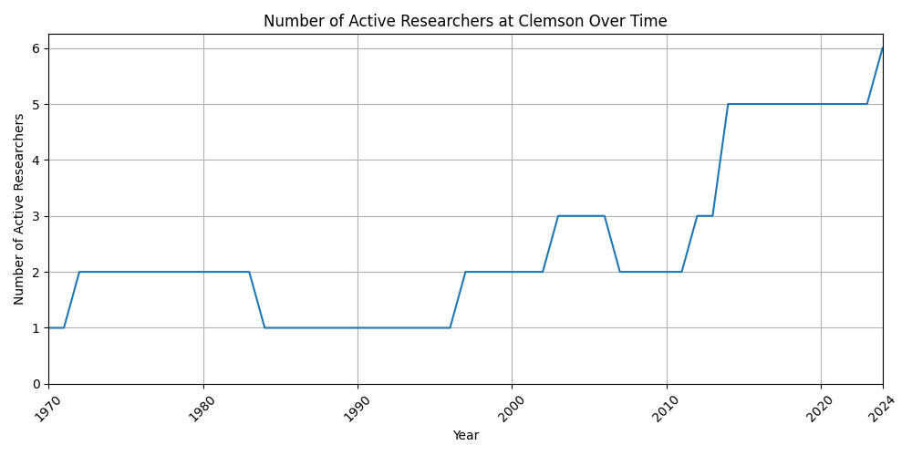
Researchers at Clemson

Slide 26
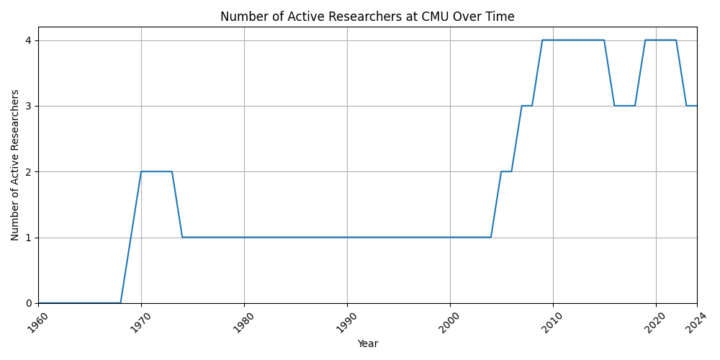
Researchers at CMU

Slide 27
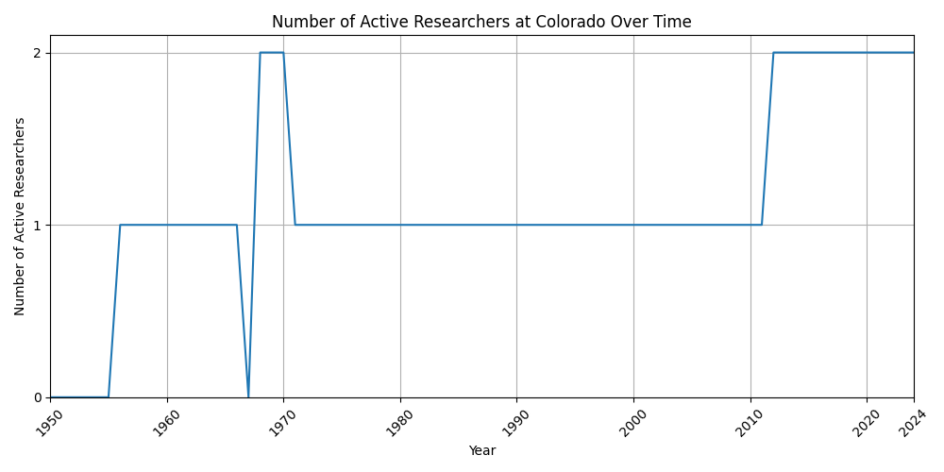
Researchers at Colorado

Slide 28
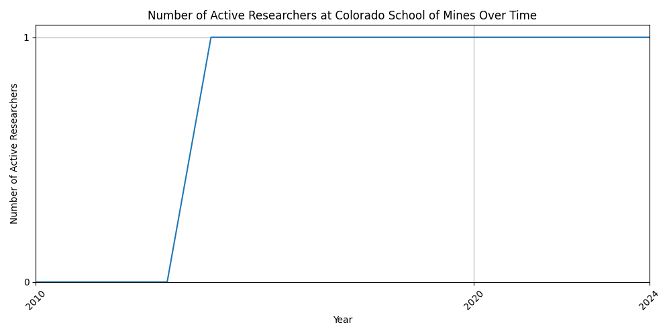
Researchers at Colorado School of Mines

Slide 29
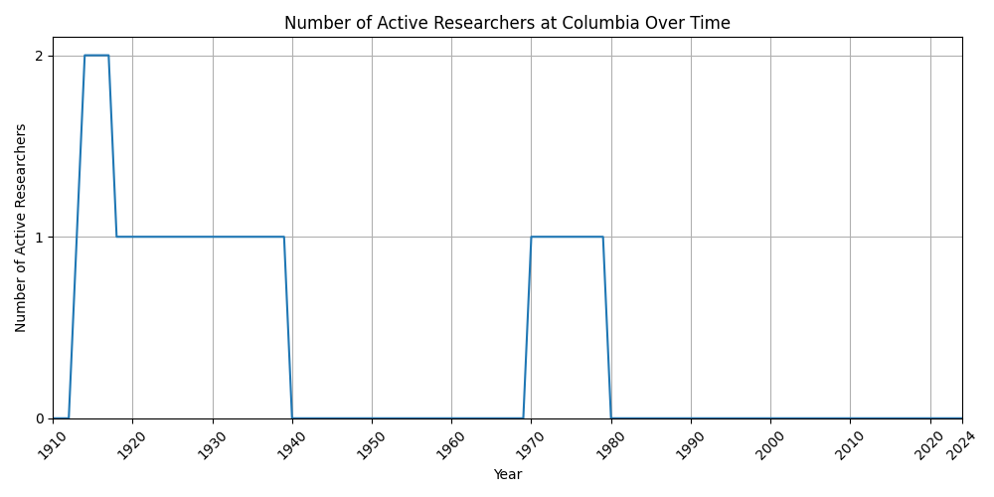
Researchers at Columbia

Slide 30
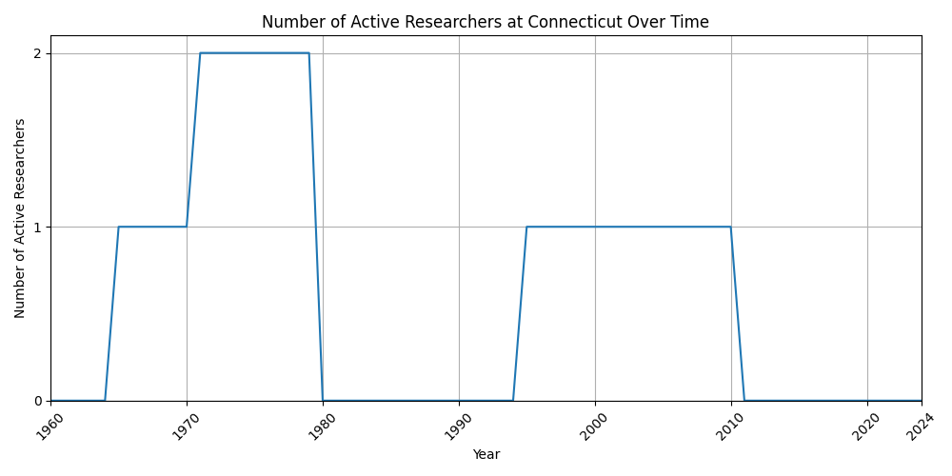
Researchers at Connecticut

Slide 31
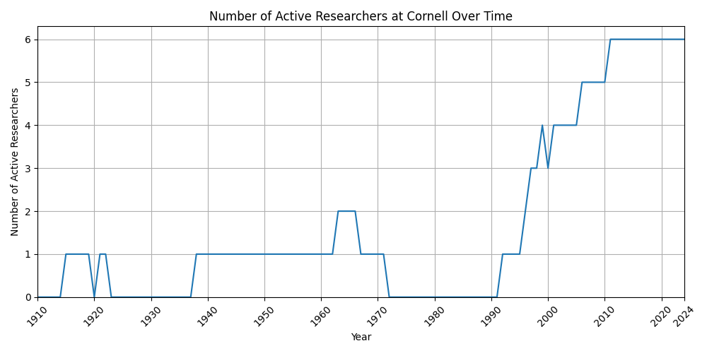
Researchers at Cornell

Slide 32
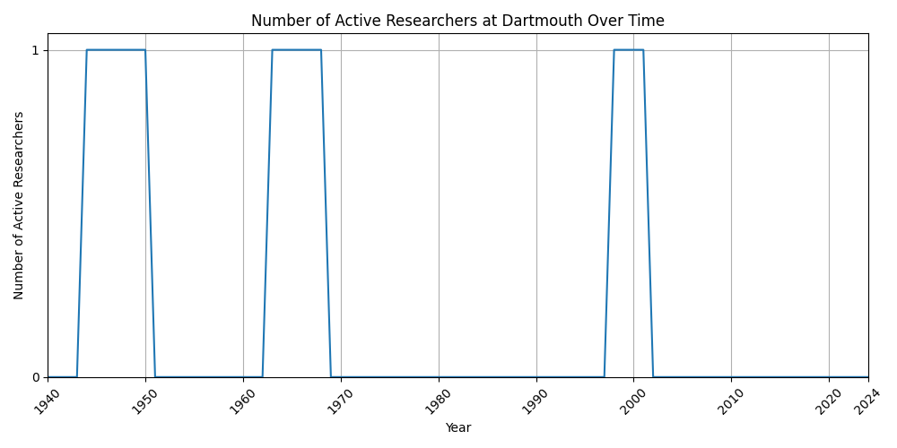
Researchers at Dartmouth

Slide 33
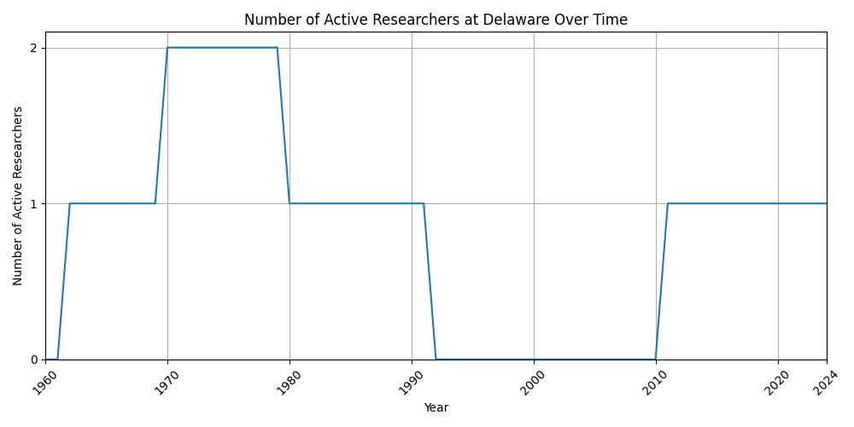
Researchers at Delaware

Slide 34
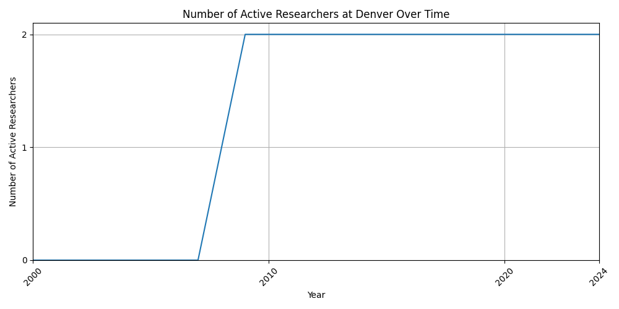
Researchers at Denver

Slide 35
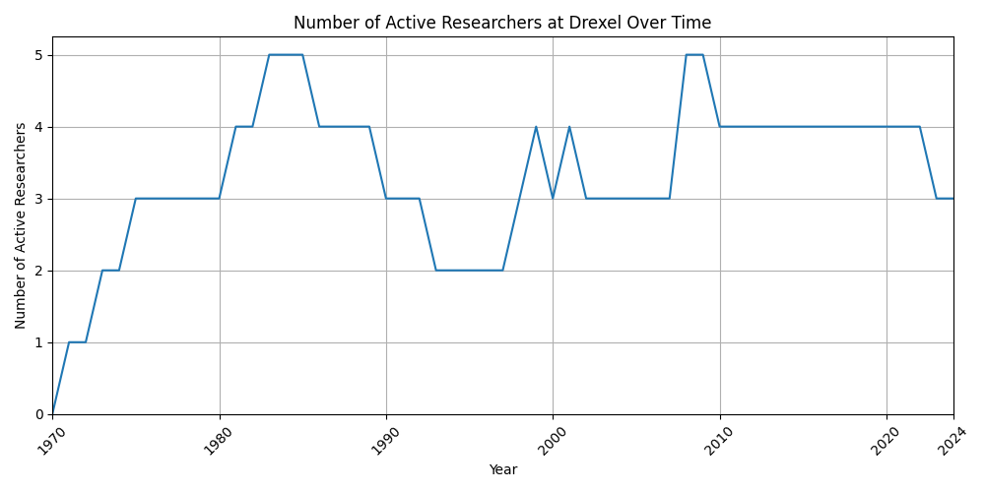
Researchers at Drexel

Slide 36
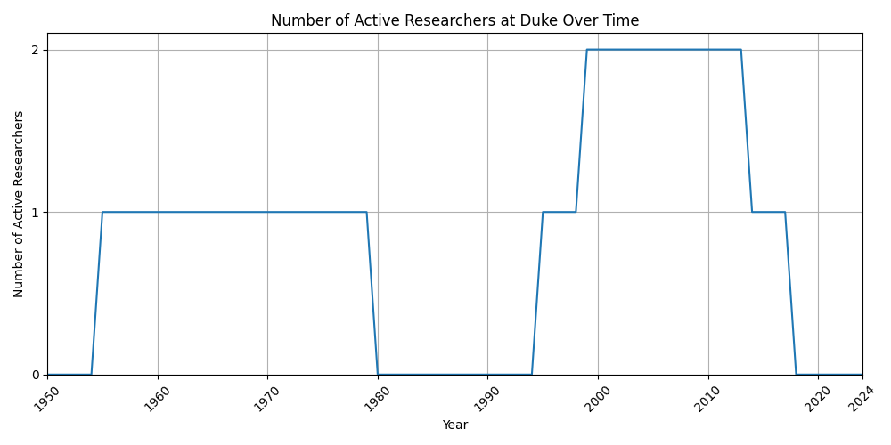
Researchers at Duke

Slide 37
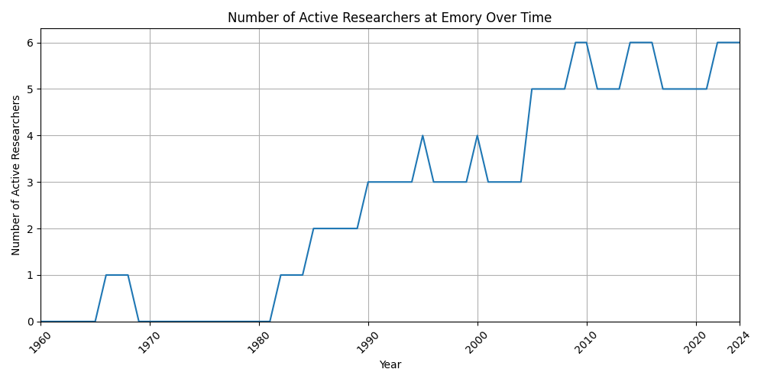
Researchers at Emory

Slide 38
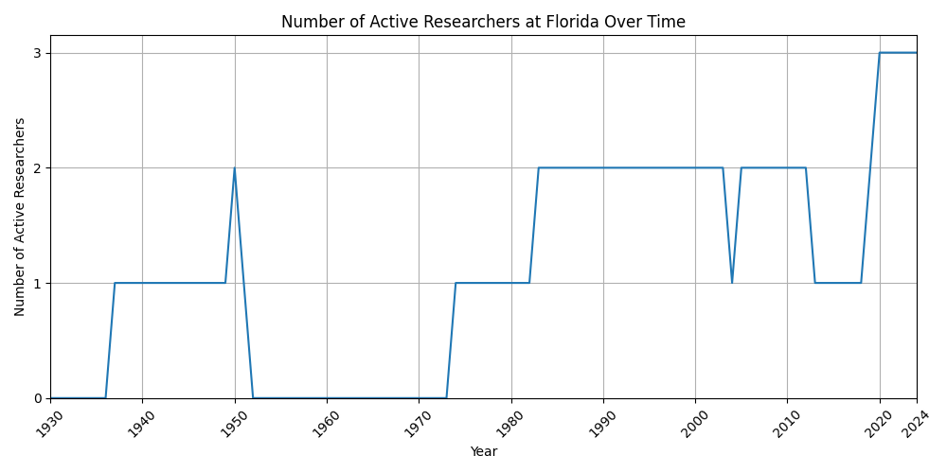
Researchers at Florida

Slide 39
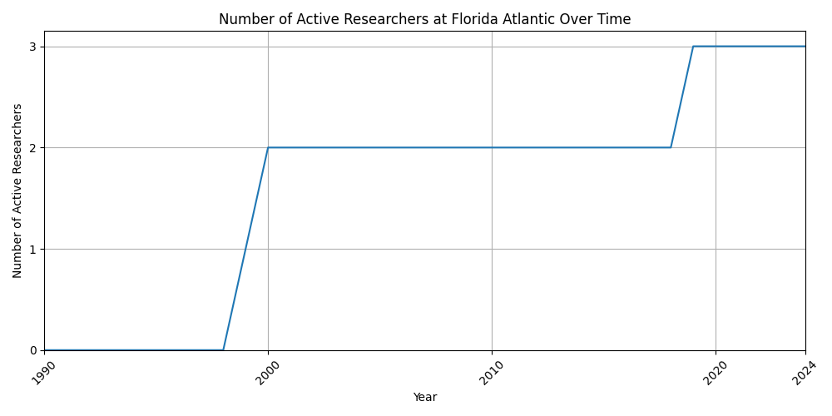
Researchers at Florida Atlantic

Slide 40
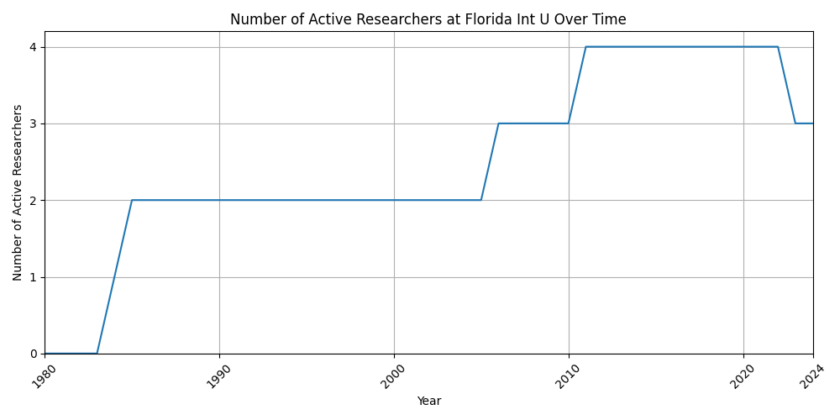
Researchers at Florida Int U

Slide 41
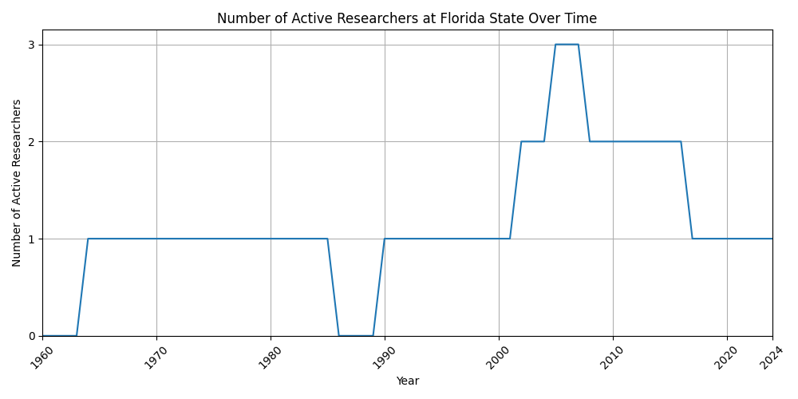
Researchers at Florida State

Slide 42
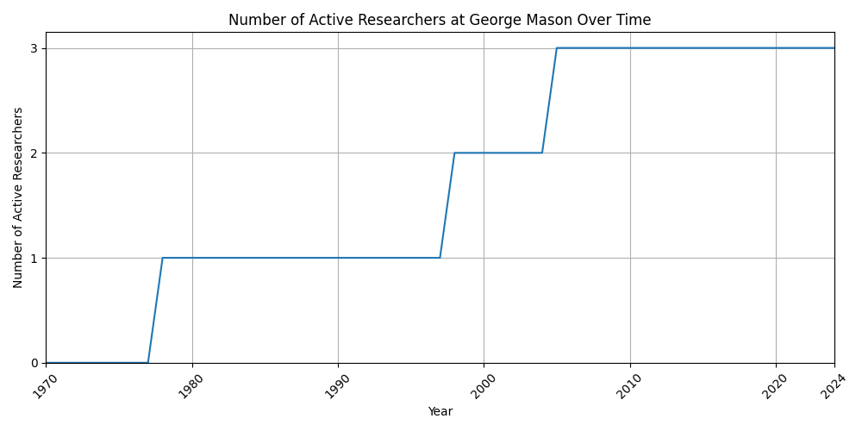
Researchers at George Mason

Slide 43
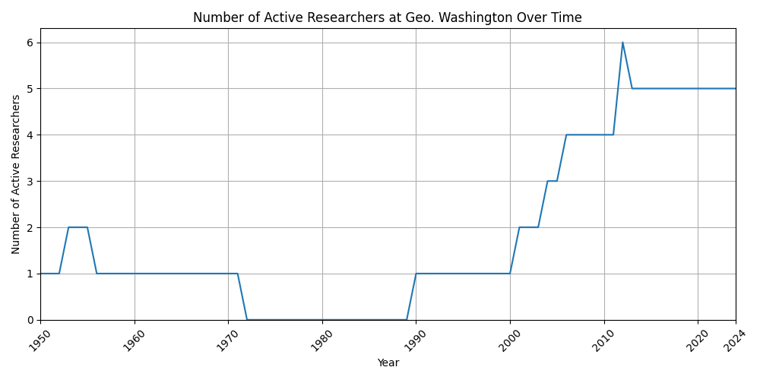
Researchers at Geo. Washington

Slide 44
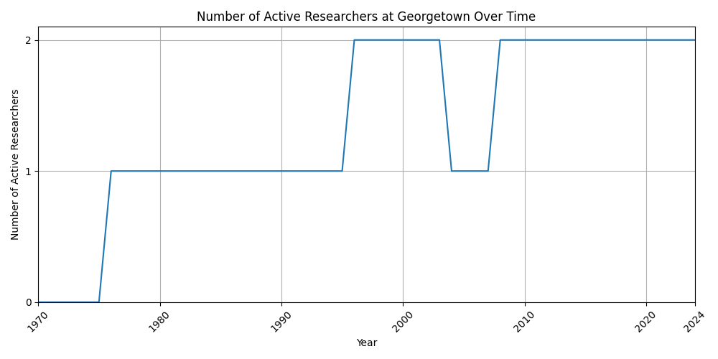
Researchers at Georgetown

Slide 45
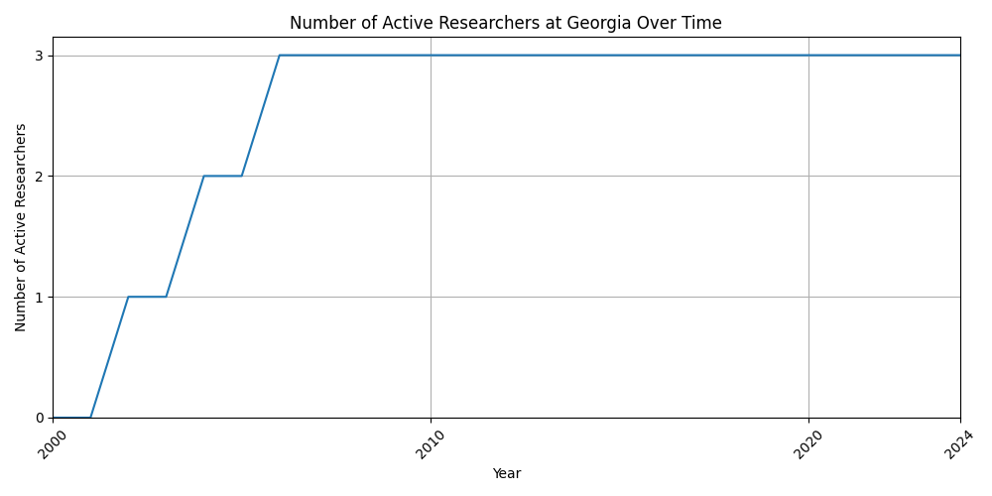
Researchers at Georgia

Slide 46
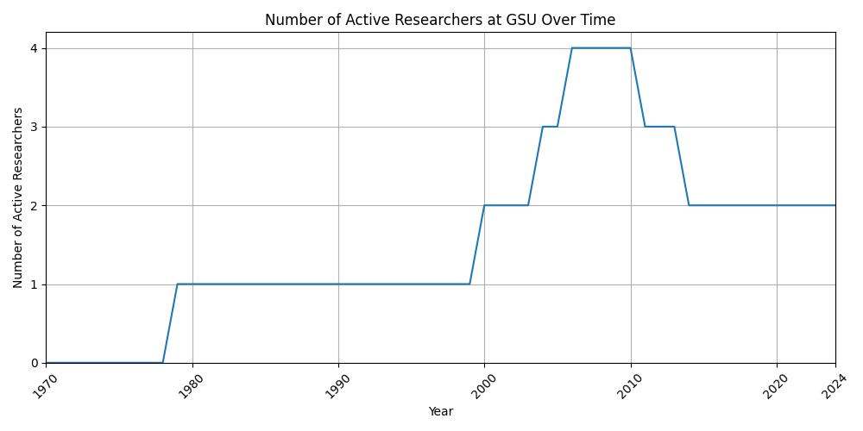
Researchers at GSU

Slide 47
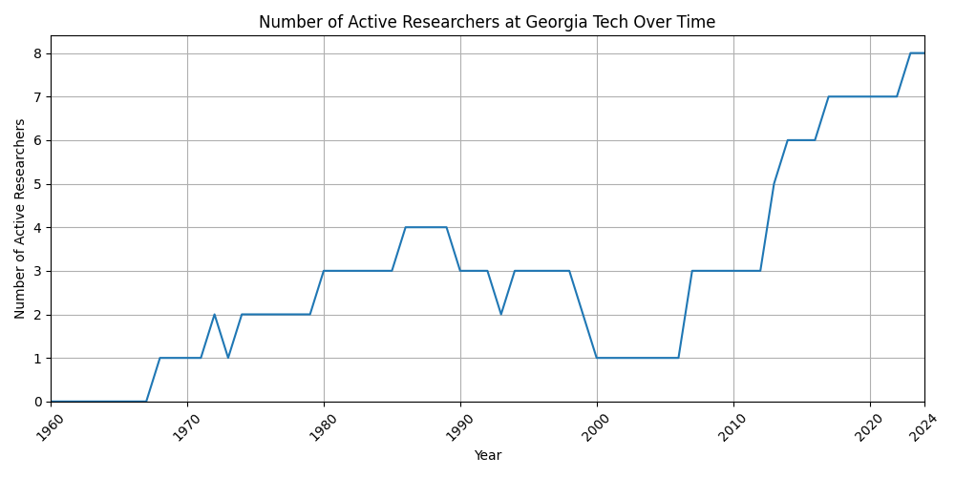
Researchers at Georgia Tech

Slide 48
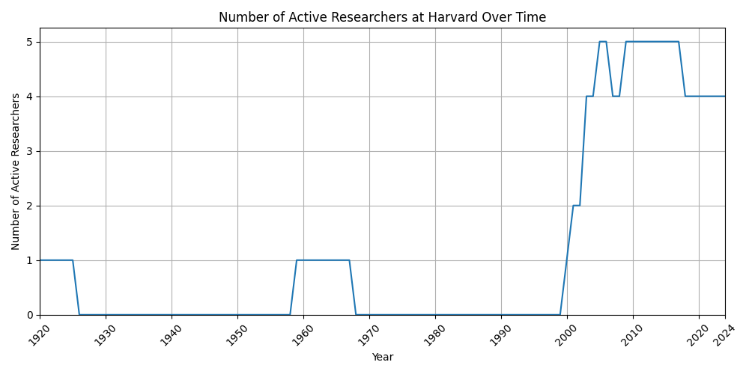
Researchers at Harvard

Slide 49
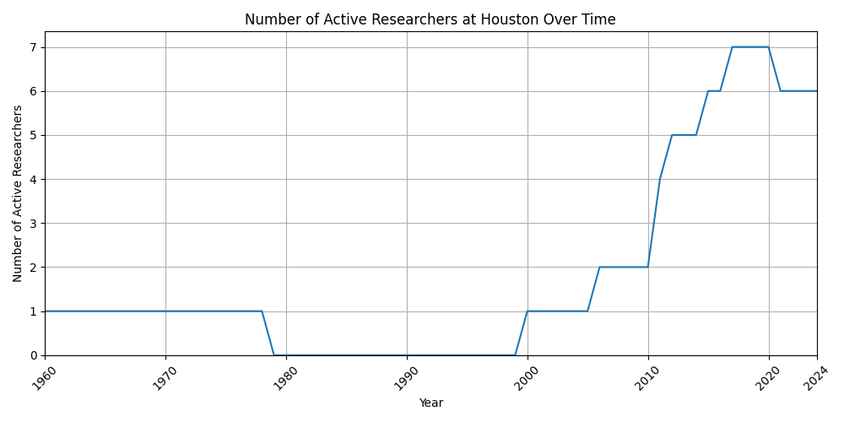
Researchers at Houston

Slide 50
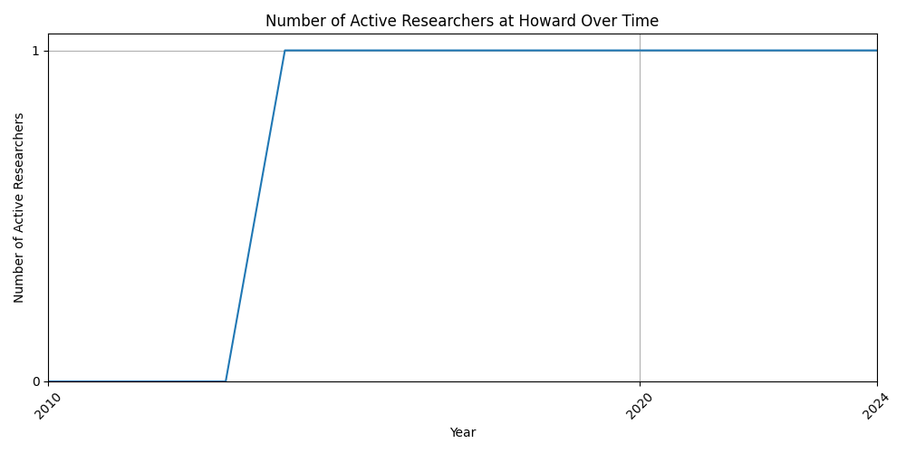
Researchers at Howard

Slide 51

Researchers at Hunter College

Slide 52

Researchers at Idaho

Slide 53

Researchers at Illinois

Slide 54

Researchers at Illinois-Chicago

Slide 55

Researchers at Illinois Tech

Slide 56

Researchers at Indiana

Slide 57

Researchers at Indiana/Purdue

Slide 58

Researchers at Iowa State

Slide 59

Researchers at Johns Hopkins

Slide 60

Researchers at Kansas

Slide 61

Researchers at Kansas State

Slide 62

Researchers at Kent State

Slide 63

Researchers at Lehigh

Slide 64

Researchers at LSU

Slide 65

Researchers at Louisville

Slide 66

Researchers at Maine

Slide 67

Researchers at Marquette

Slide 68

Researchers at Maryland

Slide 69

Researchers at Massachusetts

Slide 70

Researchers at UMass - Boston

Slide 71

Researchers at Memphis

Slide 72

Researchers at Miami

Slide 73

Researchers at Michigan

Slide 74

Researchers at Michigan State

Slide 75

Researchers at Michigan Tech

Slide 76

Researchers at Minnesota

Slide 77

Researchers at Mississippi

Slide 78

Researchers at Missouri

Slide 79

Researchers at Missouri - KC

Slide 80

Researchers at Missouri-St Louis

Slide 81

Researchers at MIT

Slide 82

Researchers at Montana State

Slide 83

Researchers at Nebraska

Slide 84

Researchers at Nevada - Reno

Slide 85

Researchers at New Hampshire

Slide 86

Researchers at New Mexico

Slide 87

Researchers at New Mexico St.

Slide 88

Researchers at North Carolina

Slide 89

Researchers at N. Carolina State

Slide 90

Researchers at North Dakota

Slide 91

Researchers at N. Dakota State

Slide 92

Researchers at North Texas

Slide 93

Researchers at Northeastern

Slide 94

Researchers at Northern Illinois

Slide 95

Researchers at Northwestern

Slide 96

Researchers at Notre Dame

Slide 97

Researchers at NYU

Slide 98

Researchers at Oakland

Slide 99

Researchers at Ohio

Slide 100

Researchers at Ohio State

Slide 101

Researchers at Oklahoma State

Slide 102

Researchers at Oregon

Slide 103

Researchers at Oregon State

Slide 104

Researchers at Pennsylvania

Slide 105

Researchers at Penn State

Slide 106

Researchers at Pittsburgh

Slide 107

Researchers at Portland State

Slide 108

Researchers at Princeton

Slide 109

Researchers at Purdue

Slide 110

Researchers at RPI

Slide 111

Researchers at Rhode Island

Slide 112

Researchers at Rice

Slide 113

Researchers at Rochester

Slide 114

Researchers at Rochester Tech

Slide 115

Researchers at Rutgers

Slide 116

Researchers at Rutgers-Camden

Slide 117

Researchers at South Carolina

Slide 118

Researchers at Stanford

Slide 119

Researchers at Stevens

Slide 120

Researchers at Stony Brook

Slide 121

Researchers at Syracuse

Slide 122

Researchers at Temple

Slide 123

Researchers at Tennessee

Slide 124

Researchers at Texas

Slide 125

Researchers at Texas A&M

Slide 126

Researchers at Texas Arlington

Slide 127

Researchers at Texas Christian

Slide 128

Researchers at Texas Dallas

Slide 129

Researchers at Texas San Antonio

Slide 130

Researchers at Texas Tech

Slide 131

Researchers at Toledo

Slide 132

Researchers at Tufts

Slide 133

Researchers at Tulane

Slide 134

Researchers at UC Berkeley

Slide 135

Researchers at UC Davis

Slide 136

Researchers at UC Irvine

Slide 137

Researchers at UCLA

Slide 138

Researchers at UC Merced

Slide 139

Researchers at UC Riverside

Slide 140

Researchers at UCSB

Slide 141

Researchers at UC Santa Cruz

Slide 142

Researchers at UCSD

Slide 143

Researchers at USC

Slide 144

Researchers at USF

Slide 145

Researchers at Utah

Slide 146

Researchers at Utah State

Slide 147

Researchers at Vanderbilt

Slide 148

Researchers at Vermont

Slide 149

Researchers at Virginia

Slide 150

Researchers at Virginia Tech

Slide 151

Researchers at VCU

Slide 152

Researchers at Wake Forest

Slide 153

Researchers at U Washington

Slide 154

Researchers at Washington U

Slide 155

Researchers at Wesleyan

Slide 156

Researchers at Wisconsin

Slide 157

Researchers at UW-Milwaukee

Slide 158

Researchers at West Virginia

Slide 159

Researchers at Western Reserve

Slide 160

Researchers at Worcester Poly

Slide 161

Researchers at Wyoming

Slide 162

Researchers at Yale

